Slide 1
Focus: Curbing Distraction
2025
Consistent, simple task management
Capstone
Presenter: Xavier Henry

Slide 2
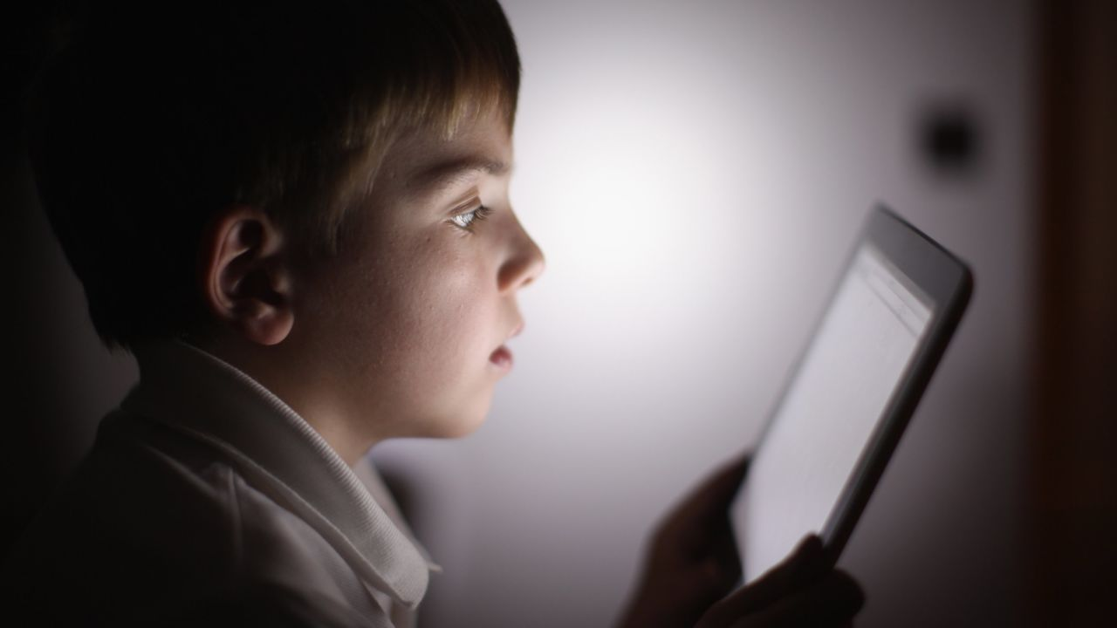


Problem?
Distraction.

Slide 3
Problem?
Worldwide attention deficit is a long-persisting challenge first highlighted by a 2015 Microsoft Canada study, revealing half of respondents struggled to sustain attention during simple tasks.
Additionally, people on the autism spectrum heavily rely on simple, repetitive daily routines. Deviation from such may result in meltdowns or stress responses. (Howlin, 2004)
Attention aids are therefore necessary to combat cell phone use and can potentially assist neurodivergent people (having an atypically functioning brain).

Slide 4
Problem?
50%
8Hr
Directly Proportional
Young adults struggled to sustain attention during simple tasks in a professional/domestic setting.
Microsoft Canada (2015)
Average daily screen time for teenagers
A direct proportional relationship between screen time and autism diagnoses

Slide 5
Why are we so Distracted?

Slide 6
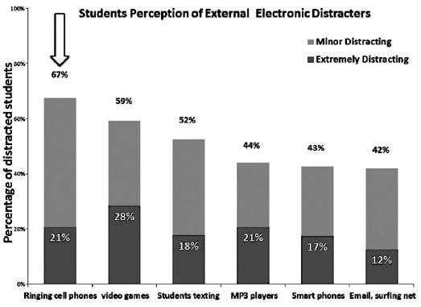
Pakistani College Students’ Perception of Distractors

Slide 7
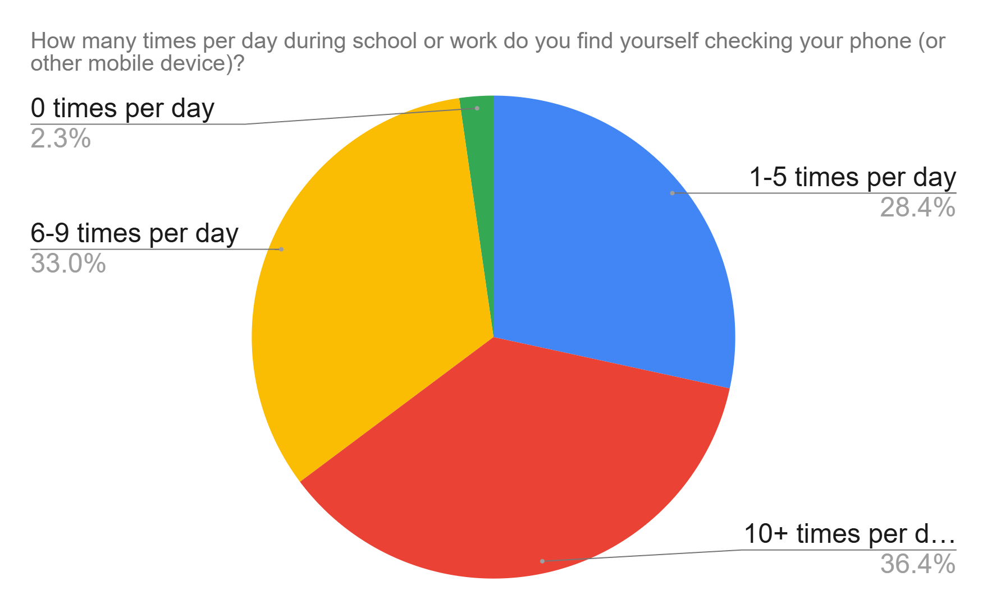
Survey within Jenkins High School, Savannah, GA, USA (Jan.-Feb. 2025) -> 88 respondents
60% of respondents noted that their primary scheduling device was their cell phone

Slide 8
Autism?

Slide 9
2022 Japanese Study Findings
Positive correlation between longer device screen times at one (1) year of age and autism spectrum disorder at three (3) years of age (Kushima et. al, 2022), which has been attributed to issues with eye contact due to screen usage.
Existing symptoms are exacerbated by screen usage.
Decreased communication score; decreased fine motor skills; decreased problem-solving scores; decreased personal communication scores over 2 hours of screen time.

Slide 10
Maintaining a Daily Routine
Dr. Cathryn Lehman - Psychologist at the Center for Autism and Developmental Disorders at the University of Pittsburgh Medical Center
Praises prompting devices as effective tools for maintaining schedules for children on the spectrum.

Slide 11
Solving the problem (Executive Summary)
Aim: To develop a cost-effective device to help young children and adolescents (including those who are neurodivergent) with completing daily tasks that are hindered by distracting mobile devices.
Visual and auditory stimulation at scheduled times for activities
Design specifications should be made to cater to declining attention spans.

Slide 12
Prior Solutions?
Very Few….

Slide 13
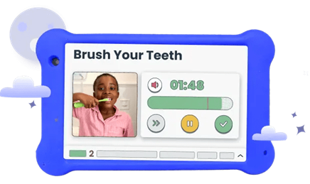
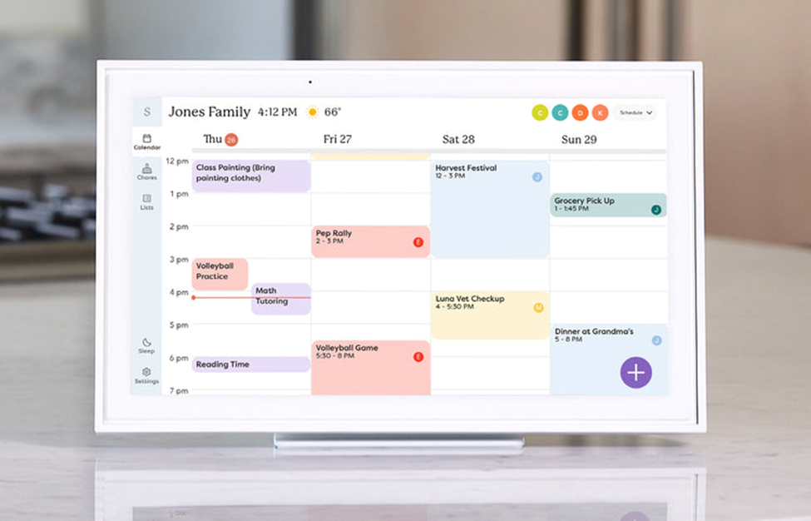
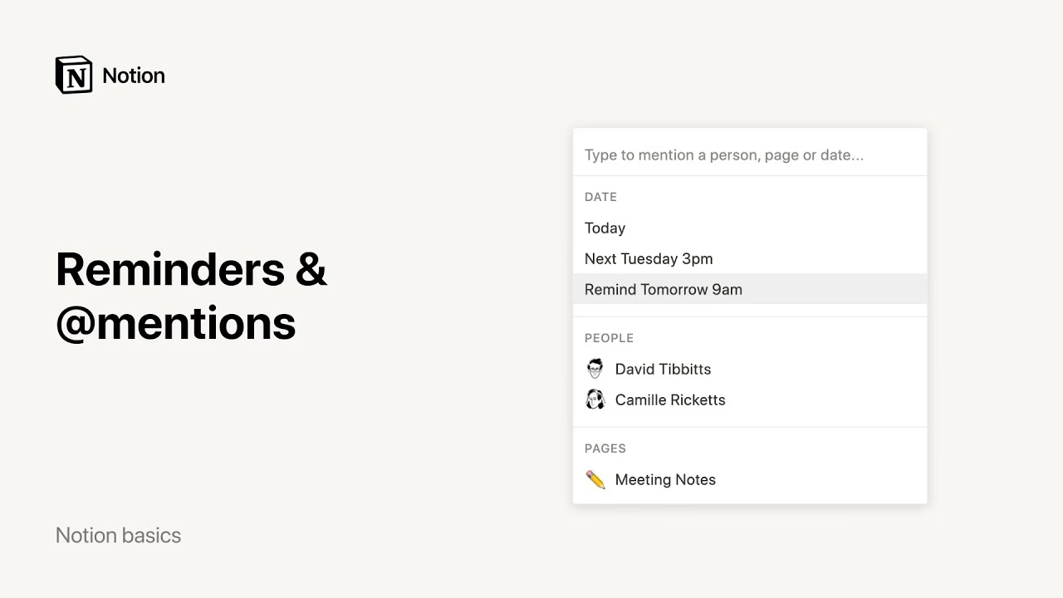
Prior Solutions
Goally
Skylight Calendar
Notion

Slide 14
Lessons from Prior Solutions… 1) Ease of use 2) Lacks Potential for Distraction 3) Reliability 4)Minimalistic Features *Suggested by 2 experts in education with decades of experience handling neurodivergent and neurotypical elementary school children*

Slide 15
Ideal Solution?

Slide 16
4) Simple User Interface
1) Affordability and Availability
2) Reliable alerting system
3) Reliable time monitoring

Slide 17
Prototyping

Slide 18
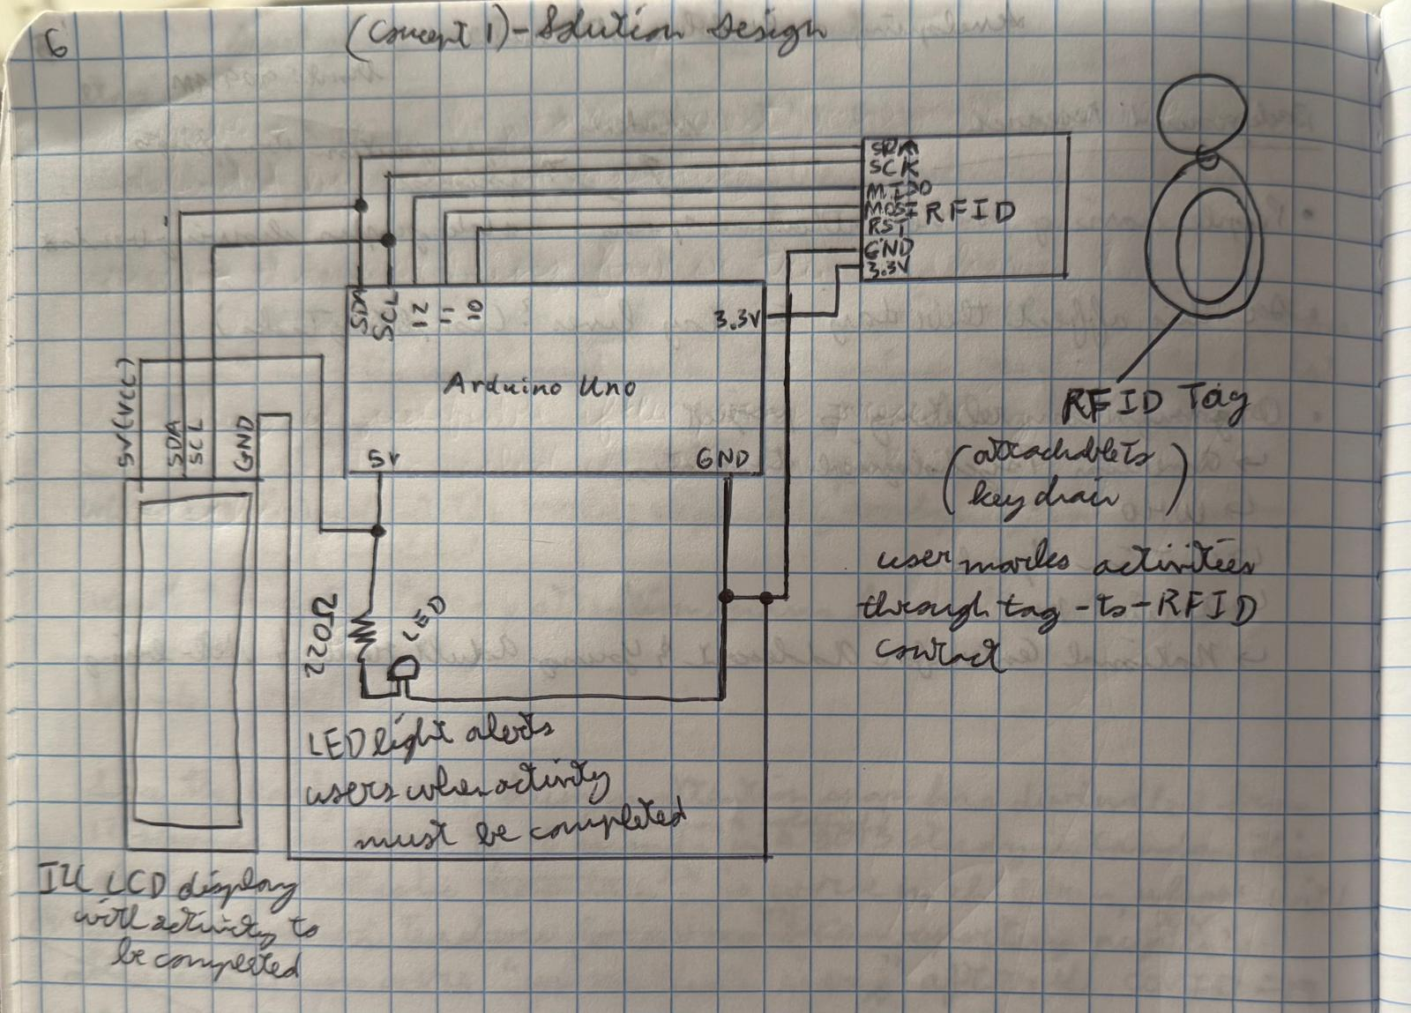
Solution 1
Benchmark Category | Rating | Notes
Affordability and availability | 5 | Arduino components are noted for their affordability and are available on third-party marketplaces such as Amazon and Elegoo.
Reliable alert system | 3 | While the flashing LED would alert most users, without auditory or kinesthetic stimuli, users may ignore the alert entirely (whether intentionally or unintentionally)
Reliable time monitoring | 2 | Time monitoring would use the Arduino’s internal clock that notes the starting time and counts seconds to calculate the current time. However, fluctuations in power could disrupt its internal clock.
Simple user interface | 3 | The unique tag programmed specifically for the device’s sensor poses a complex challenge when the tag is misplaced or damaged, rendering the device temporarily useless.
Lacks distracting features | 5 | No majorly distracting components or functionality

Slide 19
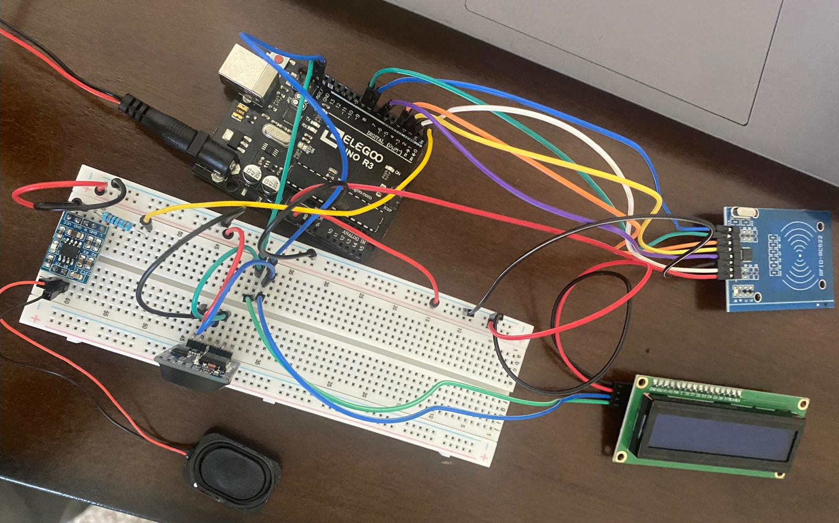

Slide 20
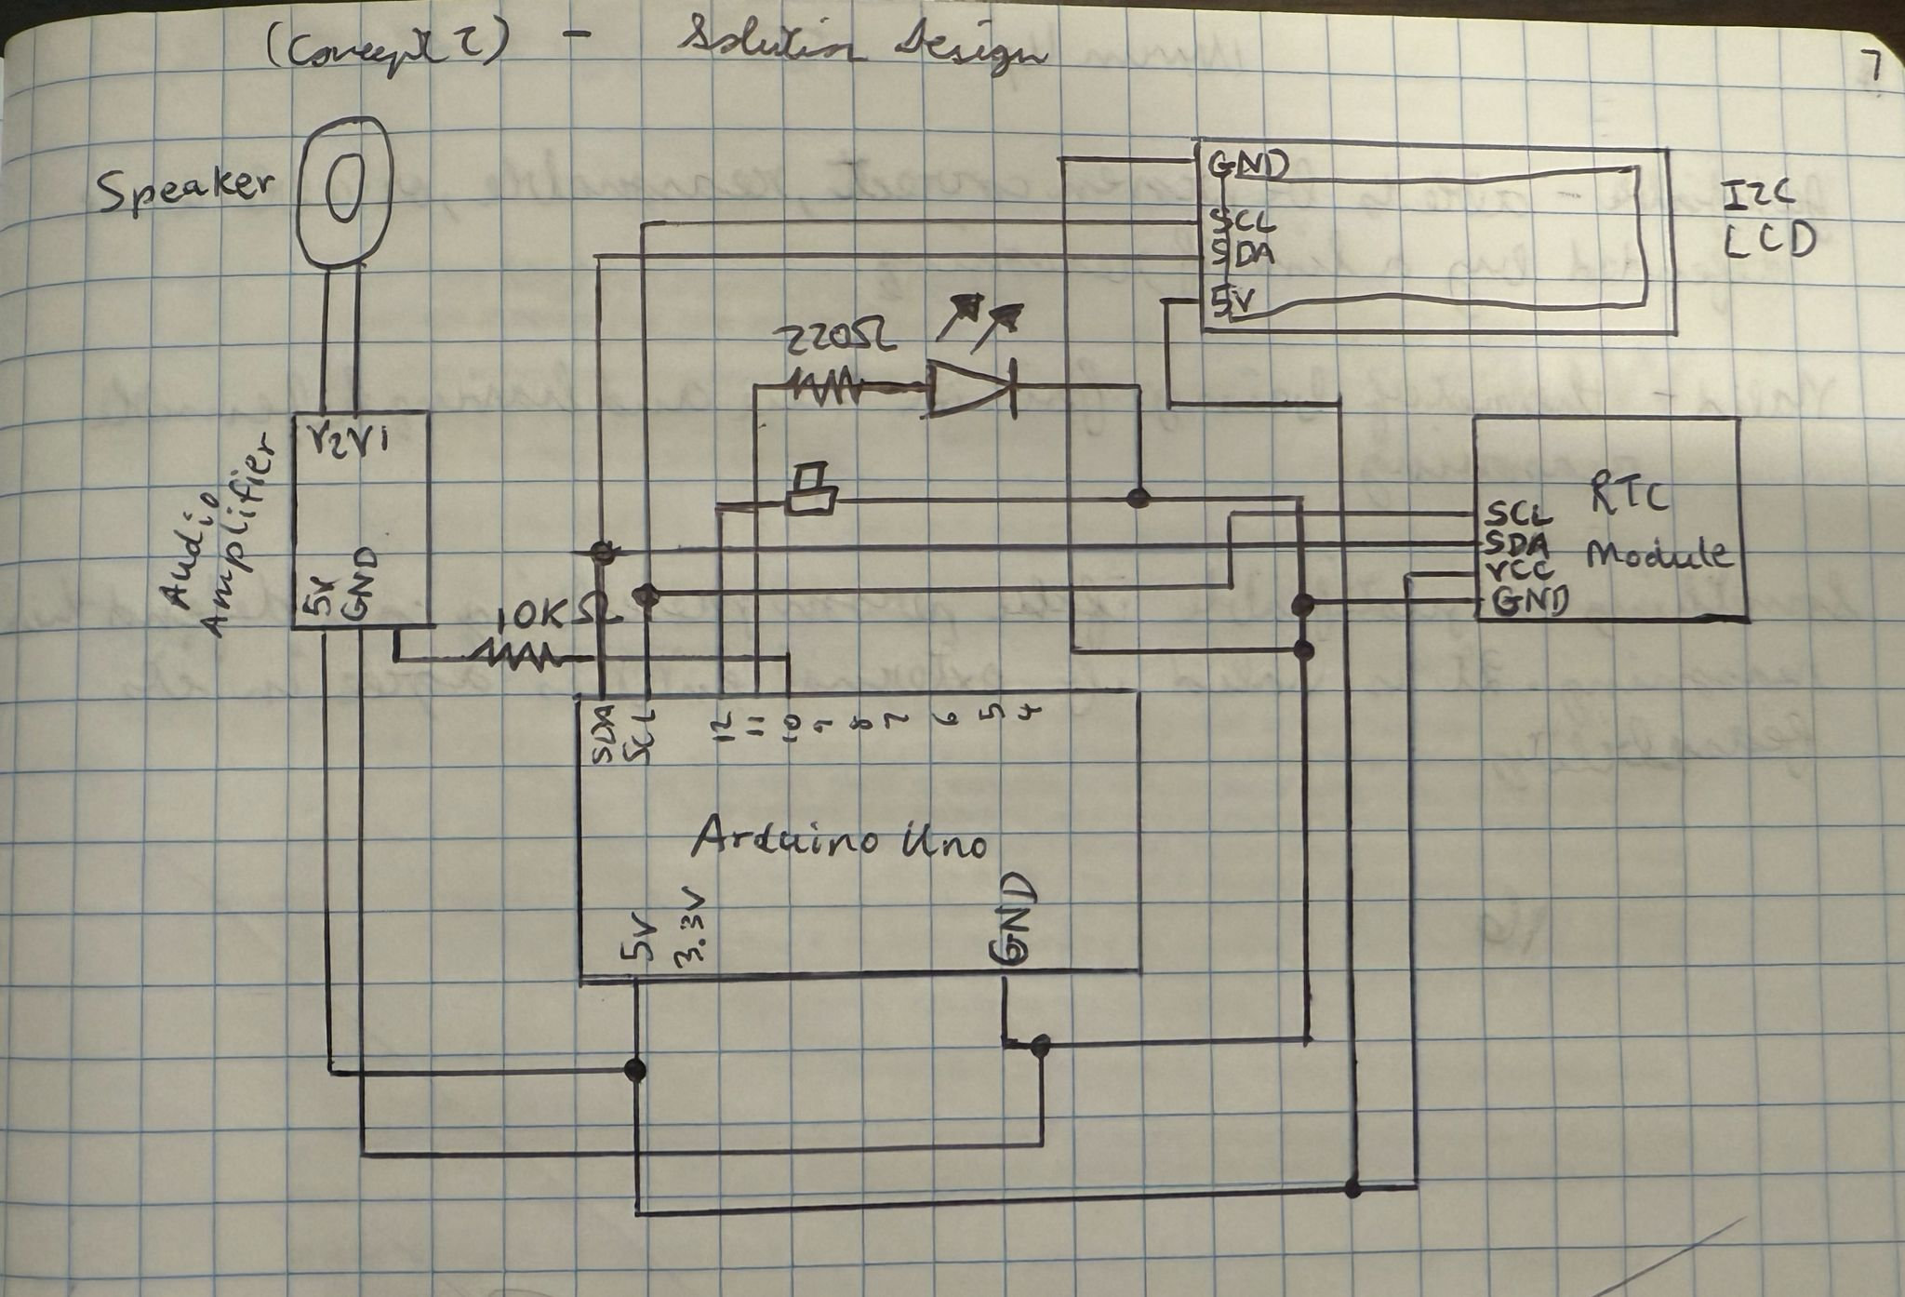
Benchmark Category | Rating | Notes
Affordability | 5 | Arduino components are noted for their affordability and are available on third-party marketplaces such as Amazon and Elegoo.
Reliable alert system | 5 | The visual stimulus of the LED as well as the audible jingle from the speaker should be sufficient to alert users, especially if their attention is not turned toward the device.
Reliable time monitoring | 5 | The independent real-time clock will reliably keep track of time regardless of whether the device itself is turned on.
Simple user interface | 5 | The tactile button press for logging completed activities is simple enough for the average user to interact with and avoids complications from external parts.
Lacks distracting features | 5 | No majorly distracting components or functionality
Solution 2 (Chosen)

Slide 21
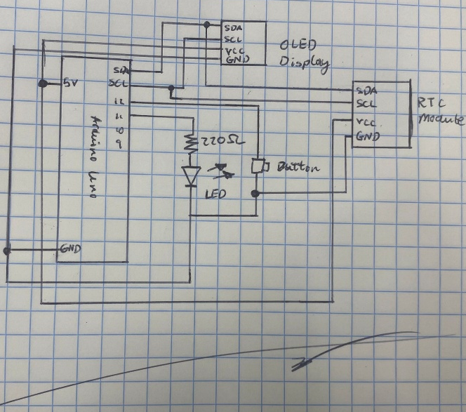
Solution 3
Benchmark Category | Rating | Notes
Affordability | 5 | Arduino components are noted for their affordability and are available on third-party marketplaces such as Amazon and Elegoo.
Reliable alert system | 2 | While the flashing LED would alert most users, without auditory or kinesthetic stimuli, users may ignore the alert entirely (whether intentionally or unintentionally) Additionally, the OLED display is much too small for users to read at a reasonable distance without squinting or straining eyes.
Reliable time monitoring | 5 | The independent real-time clock will reliably keep track of time regardless of whether the device itself is turned on.
Simple user interface | 5 | The tactile button-press for logging completed activities is simple enough for the average user to interact with and avoids complications from external parts.
Lacks distracting features | 5 | No majorly distracting components or functionality.

Slide 22
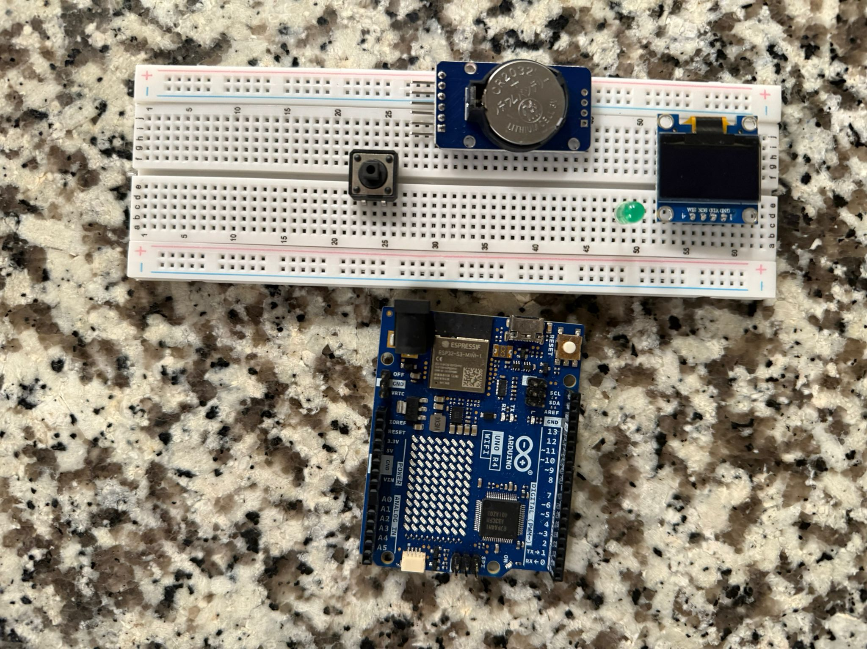

Slide 23
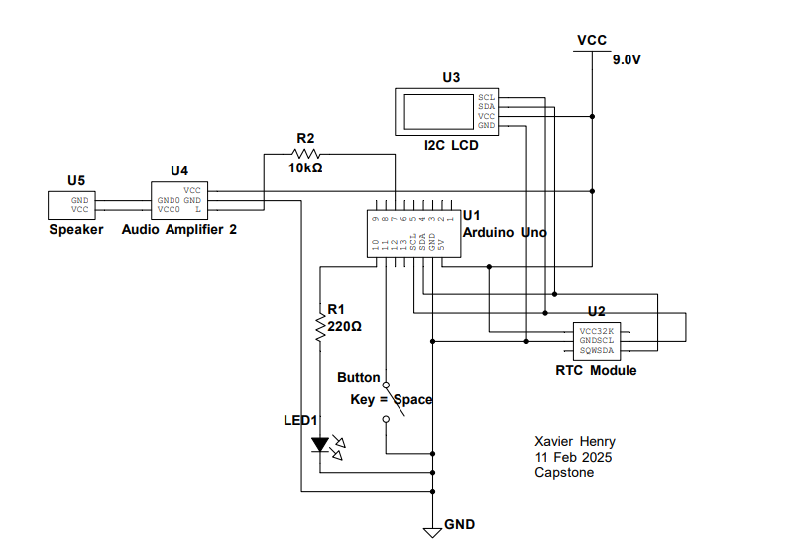
Electrical Diagram

Slide 24
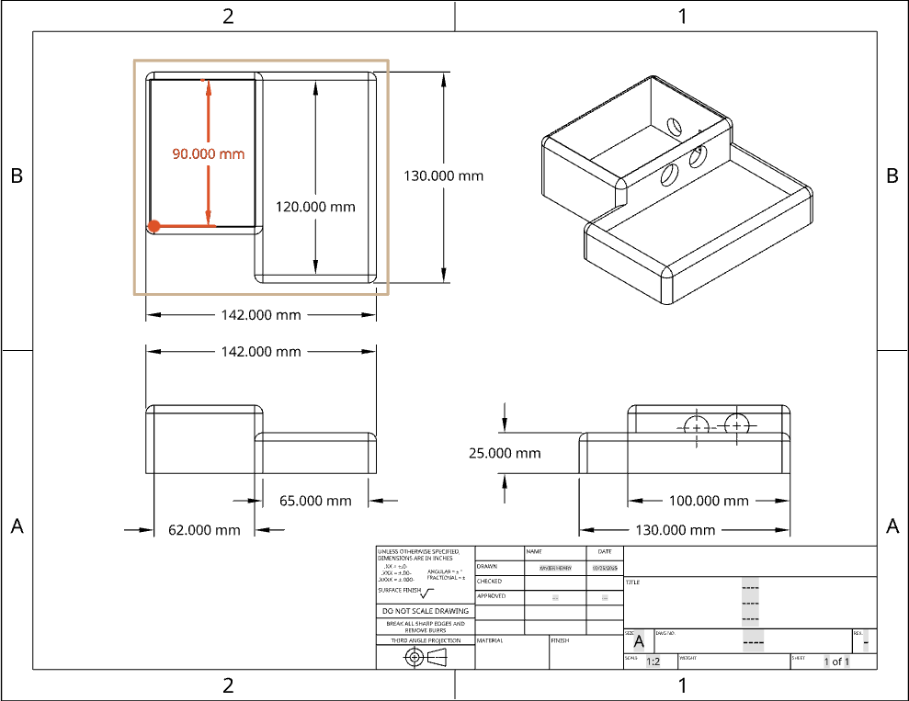
CAD Model (Product Casing)

Slide 25
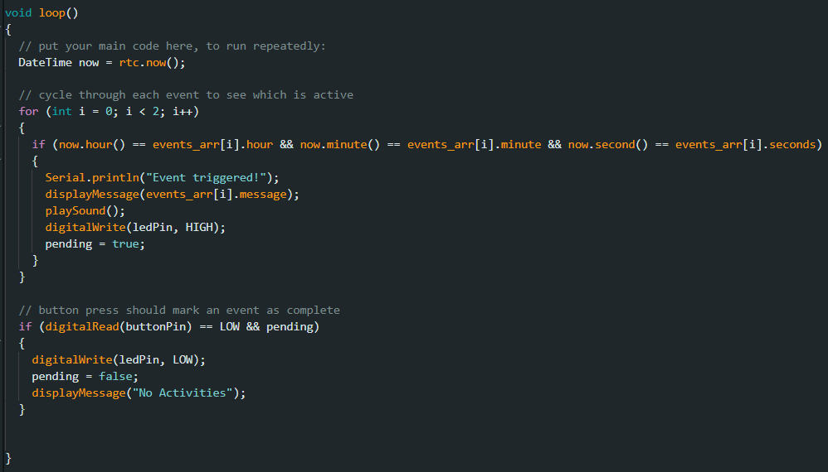
Code Snippet

Slide 26
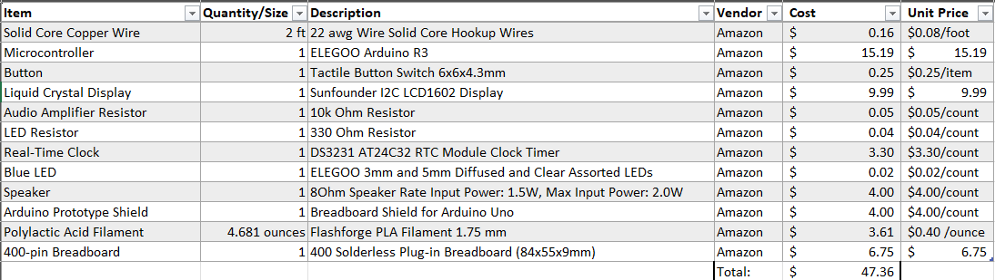
Bill of Materials
Total Cost: $47.36
Price (10% profit margin): $52.10
Shipping: ~$14.90 UPS flat rate

Slide 27
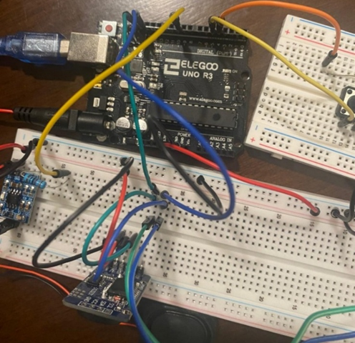
Initial Breadboarding

Slide 28
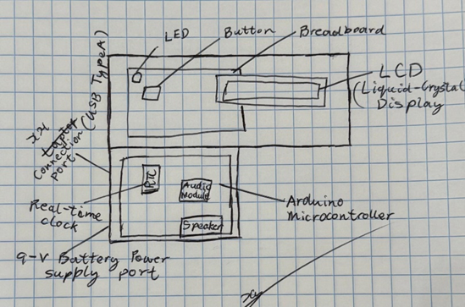
Casing Layout Sketch

Slide 29
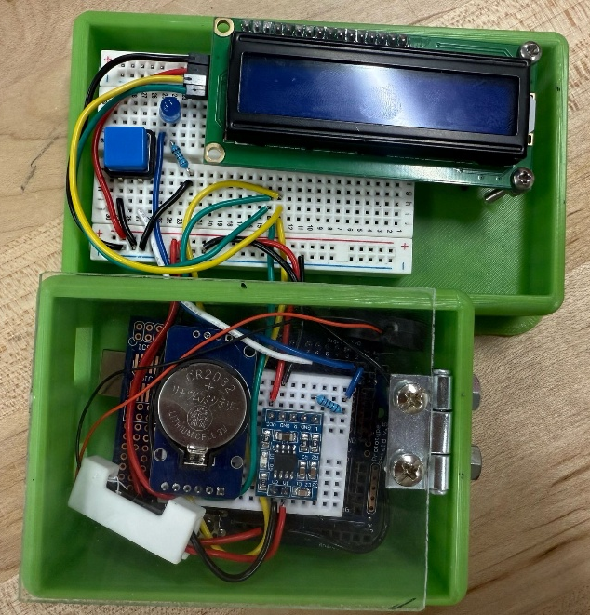
Final Prototype Layout

Slide 30
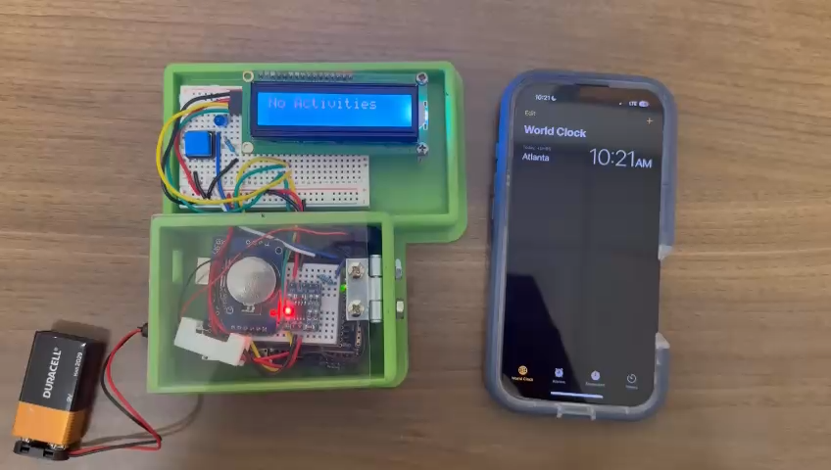
Demonstrating the Prototype

Slide 31
Testing the Prototype
4 high schoolers, 1 six-year-old child diagnosed with autism spectrum disorder (24 hours, 3-hour intervals)
Consistently identified activities and responded positively to the prototype
Description easily visible (3.8 meters)
Product works without internet and keeps time with interrupted power

Slide 32
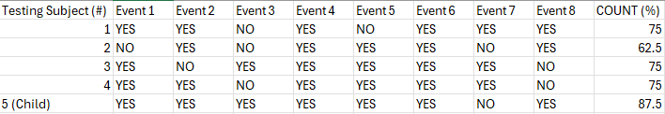
Testing the Prototype

Slide 33
Design Viability
Reusability: easily removable 9-volt battery
Non-biodegradable electrical components
Electrical components are easily recyclable (company repairs/ repurposing)

Slide 34
Beyond Capstone…

Slide 35
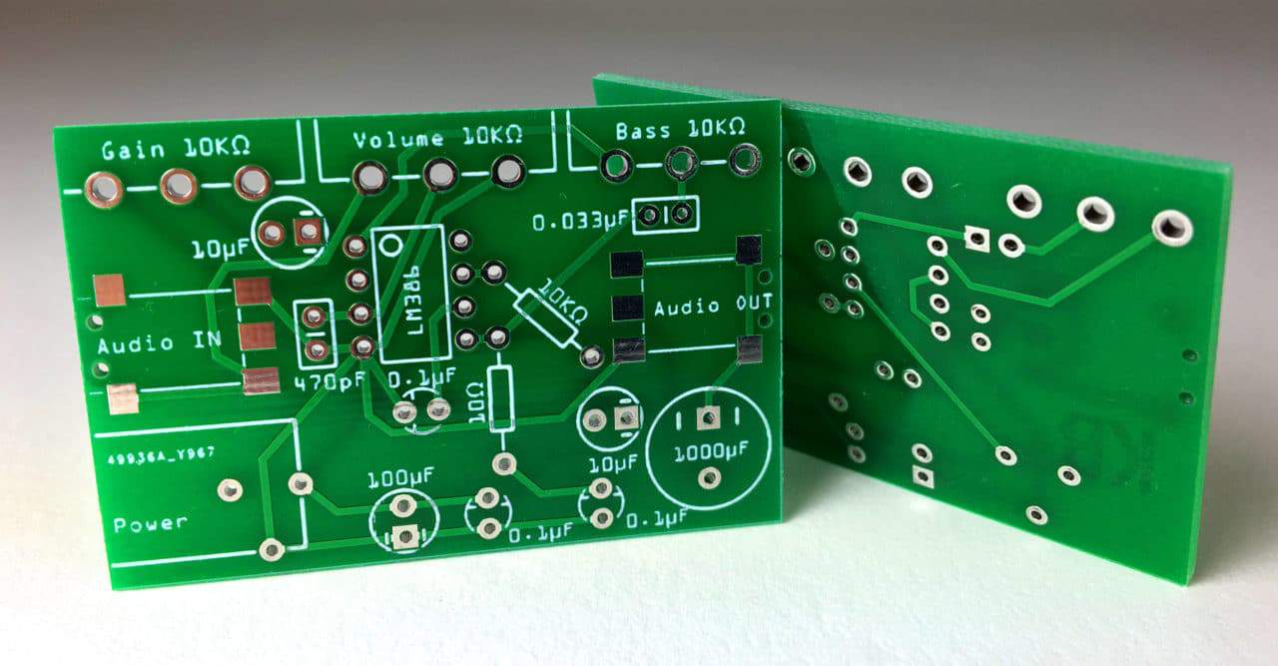

Slide 36
References
Maenner M.J., Warren Z., Williams A.R., et al. (2023, March 24). Prevalence and Characteristics of Autism Spectrum Disorder Among Children Aged 8 Years. Autism and Developmental Disabilities Monitoring Network. https://www.cdc.gov/mmwr/volumes/72/ss/ss7202a1.htm#suggestedcitation
Common Sense Media. (2021). The Common Sense Census: Media Use by Tweens and Teens. Common Sense. https://www.commonsensemedia.org/sites/default/files/research/report/8-18-census-integrated-report-final-web_0.pdf
Alrahili, N., Almarshad NA., Alturki R.Y., et al. (2021, October 14). The Association Between Screen Time Exposure and Autism Spectrum Disorder-Like Symptoms in Children. National Library of Medicine. https://pmc.ncbi.nlm.nih.gov/articles/PMC8592297/
Lu M., Pang F., Wang R., et al (2022, December). The association between autistic traits and excessive smartphone use in Chinese college students: The chain mediating roles of social interaction anxiety and loneliness. Research in Developmental Disabilities – Science Direct. https://www.sciencedirect.com/science/article/abs/pii/S0891422222001998
Davidovitch M., Shrem M., Golovaty N., et al. (2018, August) The role of cellular phone usage by parents in the increase in ASD occurrence: A hypothetical framework. Science Direct. https://www.sciencedirect.com/science/article/abs/pii/S0306987718301014?via%3Dihub

Slide 37
References
Fetta, A., Carati, E., Moneti, L., Pignataro, et al. (2021). Relationship between Sensory Alterations and Repetitive Behaviours in Children with Autism Spectrum Disorders: A Parents’ Questionnaire Based Study. Brain Sciences, 11(4), 484. https://doi.org/10.3390/brainsci11040484
Schaffler, M. D., Middleton, L. J., Abdus-Saboor, I. (2021, December 5). Mechanisms of Tactile Sensory Phenotypes in Autism: Current Understanding and Future Directions for Research. National Library of Medicine. https://pmc.ncbi.nlm.nih.gov/articles/PMC6900204/
Attention spans. (2015) Microsoft Canada. https://sherpapg.com/wp-content/uploads/2017/12/MAS.pdf
Hall, R. et al. (2023, June 7). Children’s attention span ‘shorter than ever’ since Covid crisis, say teachers in England. The Guardian. https://www.theguardian.com/education/2023/jun/07/children-attention-span-shorter-covid-crisis-teachers-england-primary
Hatfield, J. (2024, June 12). 72% of U.S. high school teachers say cellphone distraction is a major problem in the classroom. Pew Research Center. https://www.pewresearch.org/short-reads/2024/06/12/72-percent-of-us-high-school-teachers-say-cellphone-distraction-is-a-major-problem-in-the-classroom/

Slide 38
References
Skylight. (n.d.) Skylight. Retrieved April 27, 2025, from https://www.skylightframe.com/products/skylight-calendar/
Notion. (n.d.) Notion. Retrieved February 10, 2025, from https://www.notion.com/
Reduce Screen Time. (2013, February 13). National Heart, Lung, and Blood Institute https://www.nhlbi.nih.gov/health/educational/wecan/reduce-screen-time/index.htm
Kushima et al. (2022 April 1) Association Between Screen Time Exposure in Children at 1 Year of Age and Autism Spectrum Disorder at 3 Years of Age: The Japan Environment and Children's Study. National Library of Medicine. https://pubmed.ncbi.nlm.nih.gov/35099540/
Lehman, C. (n.d.) Autism and Time Management. Autism Speaks. https://www.autismspeaks.org/expert-opinion/autism-time-management
Goally. (n.d.) Goally. Retrieved April 1, 2025, from https://getgoally.com/

